Slide 1
Version Controlling
Using Git Flow

Slide 2
Why we use version controlling?
Why we use git?

Slide 3
Why?
A global standard for using git.
Prerequisite for implementing a proper CI/CD process
Helps team in productivity
Helps in avoiding deadlock situations.

Slide 4
If you don’t know something exists, you will never need it.

Slide 5
Some Questions
How frequently developers commit code?
Do they commit broken code?
Can they work in parallel?
Does work gets accepted through code review?
Is there an easy way to revert?
Is it possible to release with working features only?
Is there an easy way to automate code review?
Is work history being preserved?
Do developers resolve conflict properly?

Slide 6
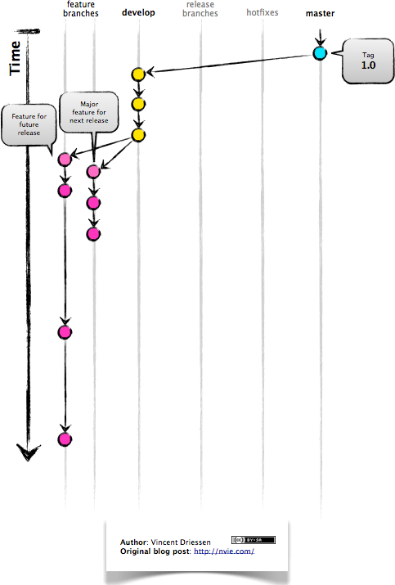

Slide 7
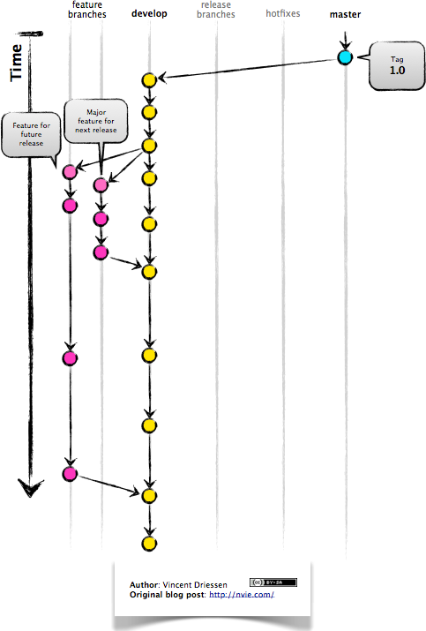

Slide 8
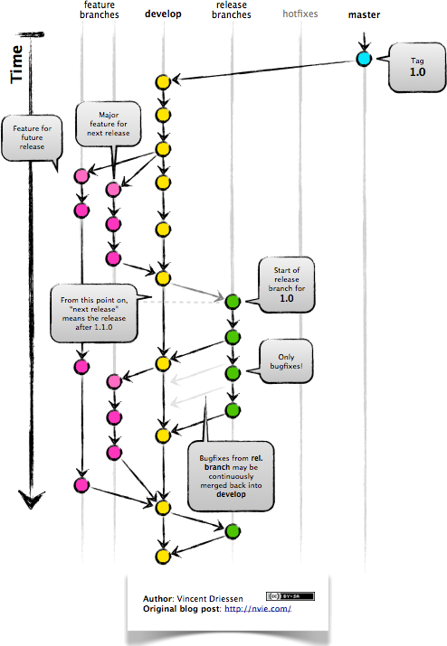

Slide 9
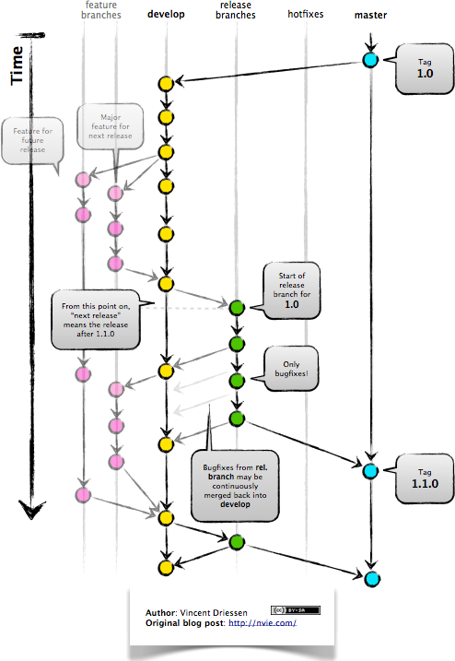

Slide 10
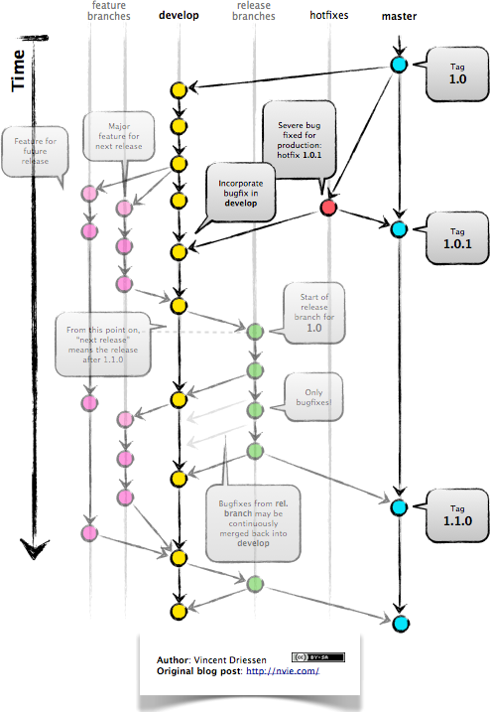

Slide 11
Required Changes
Regular developers must create feature branch from develop branch with naming convention: feature/{Jira Ticket Number} (i.e. feature/XYZ-333)
Develop branch can’t be modified without Pull Request (PR) by regular developers.
Develop branch can be changed directly by elevated permissions (Teal lead/Admin)
Master branch needs to be restricted in the same way.
Pull request must be reviewed and approved for merge. Prefered, if this can be restricted too.
Each branch and PR should trigger a CI build (Task for DevOps, developer do not need to worry)
PR should be rejected if the build fails in CI
Conflict should be resolved by PR creator by merging develop in their branch.
PR should be reviewed within 24 hours.

